Slide 1
GOVERNMENT ENGINEERING COLLEGE,PATAN
INTERSHIP ON
DATA SCIENCE
FROM
INFOLABZ IT SERVICES PVT. LTD
PARTICIPATED BY
VAIBHAV RAVAL(190220131117)
WITH GUIDANCE BY
PROF. D.U.BAVISA

Slide 2


INTRODUCTION
ABOUT COMPANY ROLE AS AN INTERN
1
2
3
4
5
6
7
OUTLINES
TOOLS AND TECHNOLOGIES
WORK REPORT CONCEPTS LEARNED REFERENCES

Slide 3

About Company
InfoLabz IT Services Pvt. Ltd.
OFFICE ADDRESS
405, Vraj Avenue, Near. Commerce Six Road, Navrangpura,
Ahmedabad, Gujarat - 380009
MENTOR
MR. CHINTAN NAGRECHA
SELECTION PROCESS
INTERVIEW (TECHNICAL + HR)
HR
MS. ZARNA SHAH

Slide 4

Role As An Intern
MACHINE LEARNING ENGINEER INTERN
As a Machine Learning Intern, my responsibilities are -
To research, modify, and apply data science and data analytics prototypes and to create and construct methods and plans for machine learning.
To search internet for training datasets that are readily available so that ML systems and models should be trained and retrained as necessary.
To create machine learning applications in accordance with client or customer needs and to investigate, test, and put into practice appropriate ML tools and algorithms.

Slide 5
Python Language
Lists Tuples Dictionary Functions Loops
Python Libraries
Numpy Pandas Matplotlib
Scikitlearn
Tools
& Tech Used
Data Analysis Microsoft Excel Power Bi Tableau kaggle
Platform PyCharm IDE Jupyter Notebook

Slide 6
Work Report
Week-01
Overview of Company Overview of Machine Learning
Python Core Concepts Advanced Python Dictionary in Python
Week-02
File Data System Microsoft Excel Data Install xlrd=1.2.0
Read Data from xlsx File Analysis of the Data Case Study - Cricket
Week-03
Dictionary in Python Functions in Python Recursive Function Lambda Function Random Module Probability and Data Science Concepts Case Study - Dream11 Numpy Concepts Dimensional Array Arithmetic Operations np.save() and np.load() file operations in
Conditional Statements API Handling Concepts Live Data Fetching Loops in Python
Case Study - Covid-19 Live Data (API) - JSON Dynamic URL Handling
Data Analysis
Extract data from Rows and Columns
File Operations - Append, Read, Write How to take User Input Conditional Statements Date-Time Package

Slide 7
Work Report
Week-04
Permutation, Concatenation, Mask (process all data in nparray): - >,
Mask op. in csv and API data
Week-05
Pie char Line chart, multiline graph, Histogram Scatterplot Multi bar graph Graphs from dictionary Graphs from csv data Fetching data from API and subplotting Assignment 2
Week-06
Pandas concepts Pandas series Pandas Dataframe Created pandas series and dataframe from python list, tuple and dictionary Excel/csv data into pandas dataframe Merge multiple dataframe(csv files) Assignment 3
Sorting, nonzero, np.where
3D array in np
Install Matplotlib
Bar graph
Assignment 1

Slide 8
Work Report
Week-07
Generating graphs from API using pandas module Pre-processing: finding null values in dataframe Data cleaning: replace the null values with 0 or required values Assignment 4
Week-08
Text extraction used split() function used contains() fun. Counter class : df.col.str.split().apply(c.upddate) hotel.csv : data Pre-processing Data cleaning create search prog. For visualization
Assignment 5
Week-09
Regular expression
re.match
re.search,re.findall
Validation of mobile number,email,pincode
Extract pin code from address
Ml- linear regression
Assignment 6

Slide 9
Work Report
Week-10
Ml -Multiple-independent variable Maths and code
Polynomoial regression-maths and code
Decision tree-maths
DS assignment 1
Week-11
Week-12
Random forest
K-Means clustering
RFM analysis
Apriori algo.
Recommendation system
Naïve bayes
Churn prediction
Visualization Using Tableau
Bar chart,piechart,scatter plot,bullet chatrt,
custome filters
Text value,wild card,condition
Calender wise sales

Slide 10
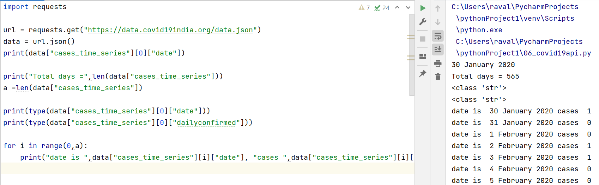
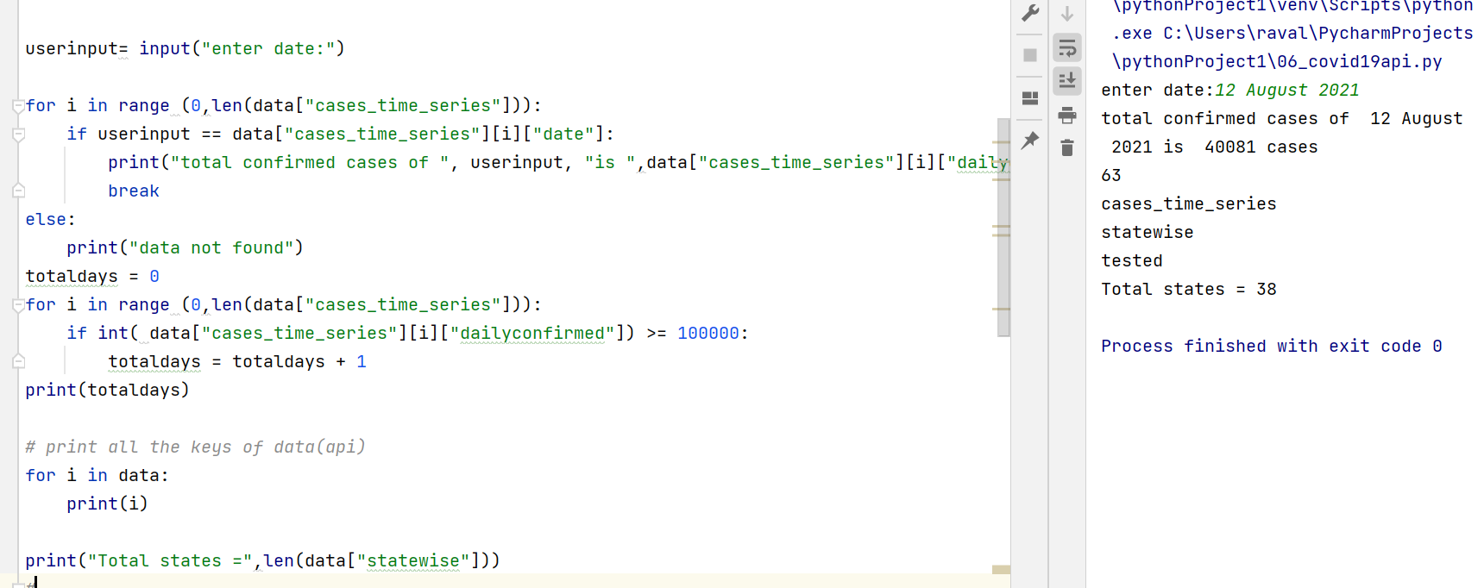
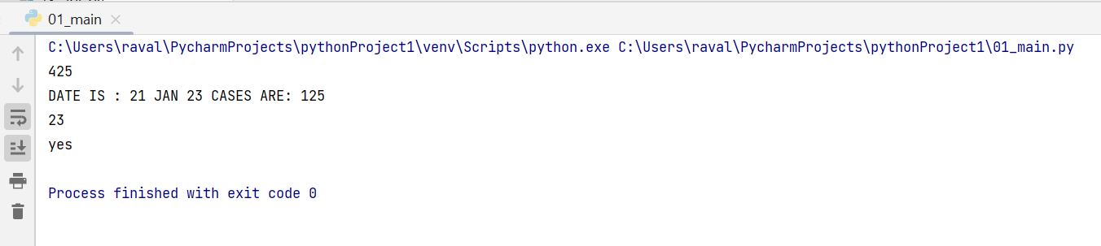
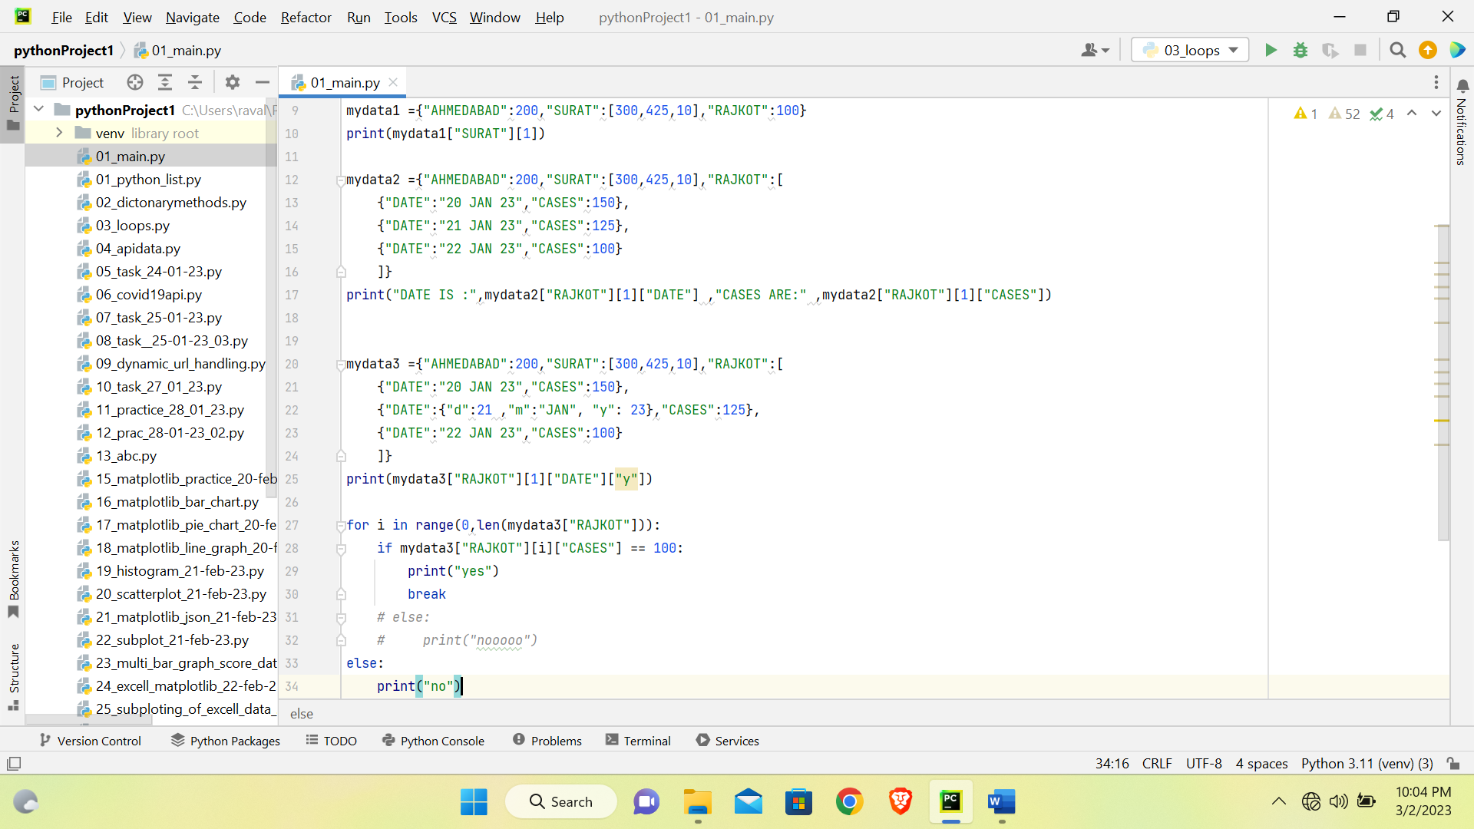
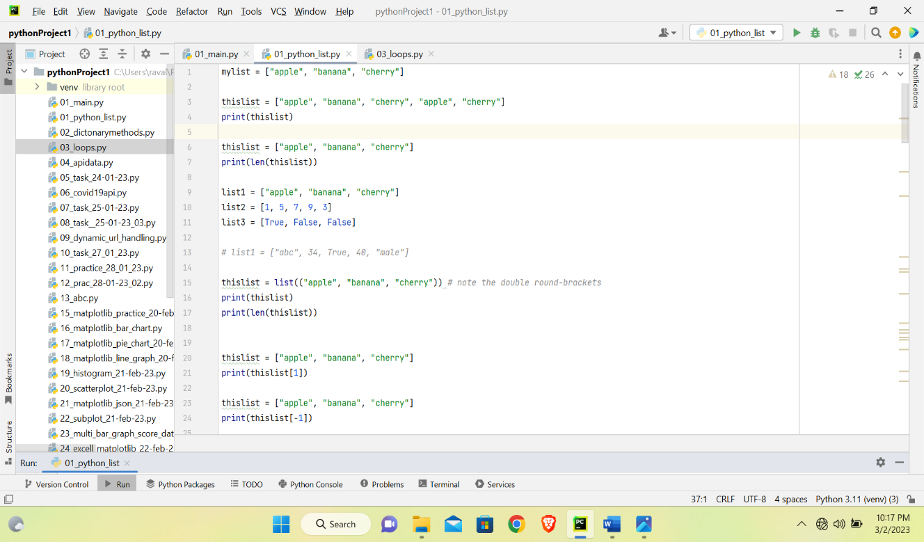
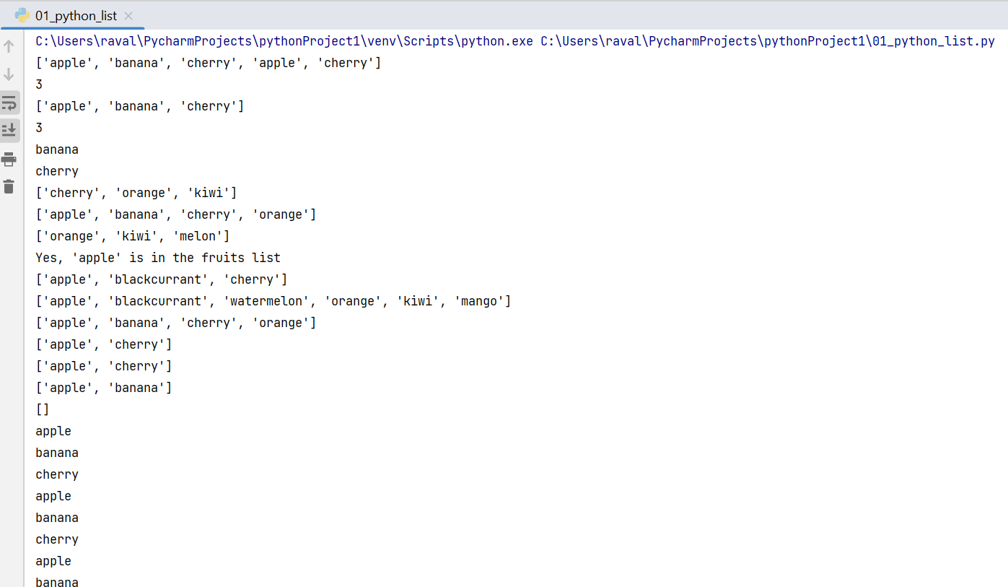
Week-01: Case Study - Covid19 Data Analysis
Dictionary Methods in Python

Slide 11
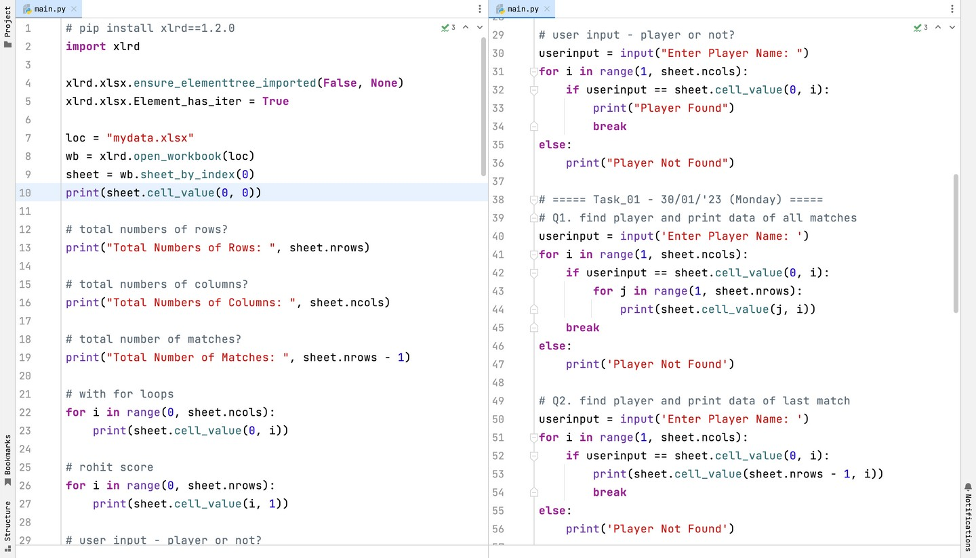
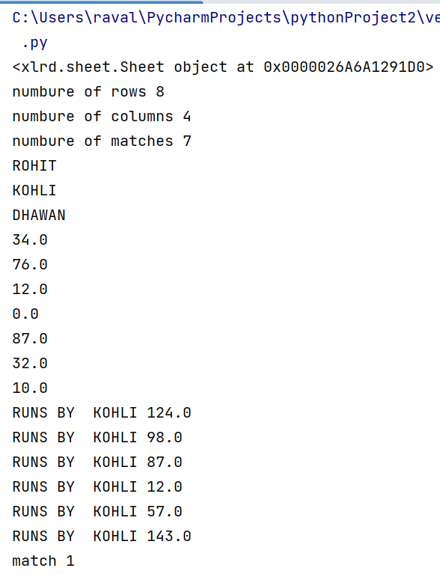
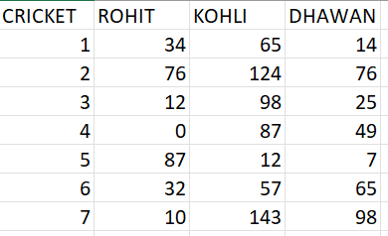
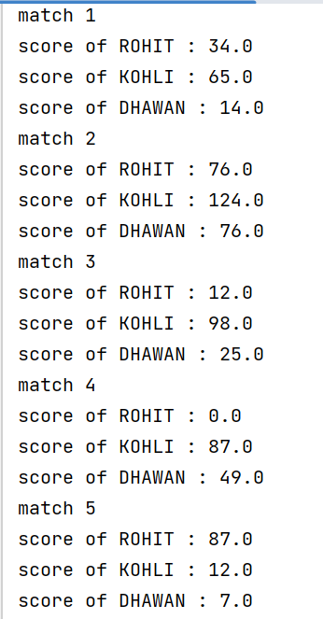
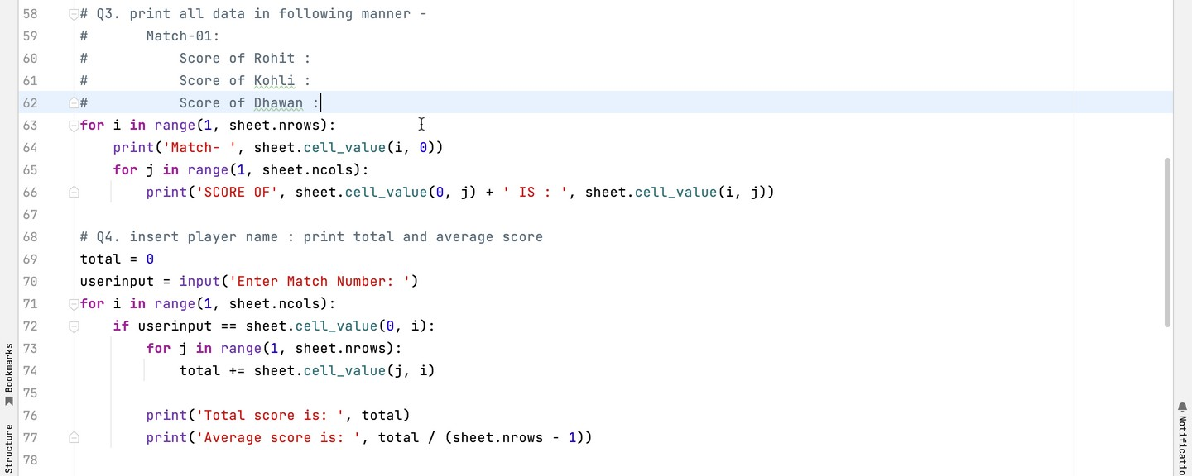
Week-02: Case Study – Cricket Data Analysis

Slide 12
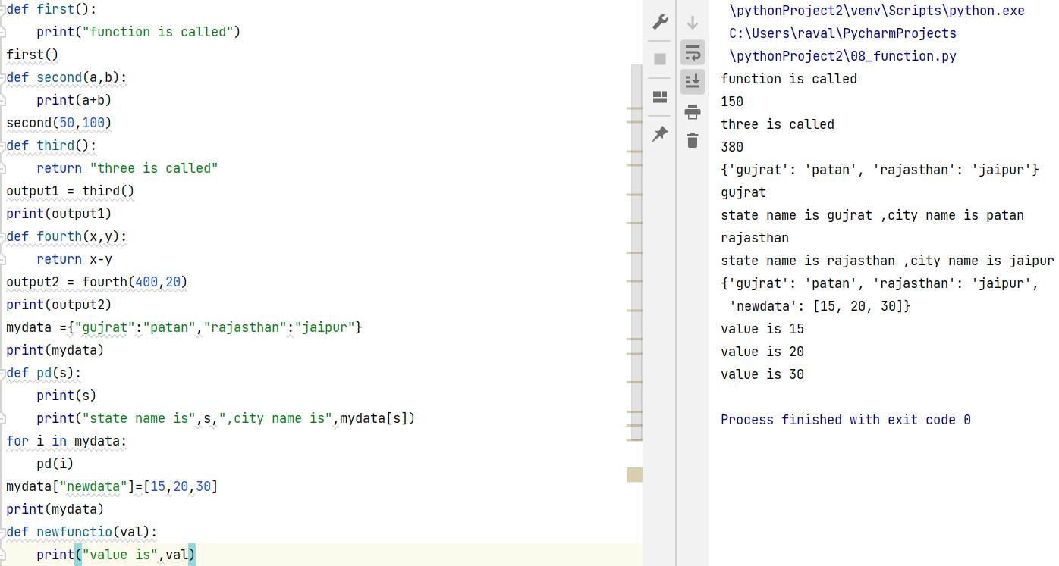
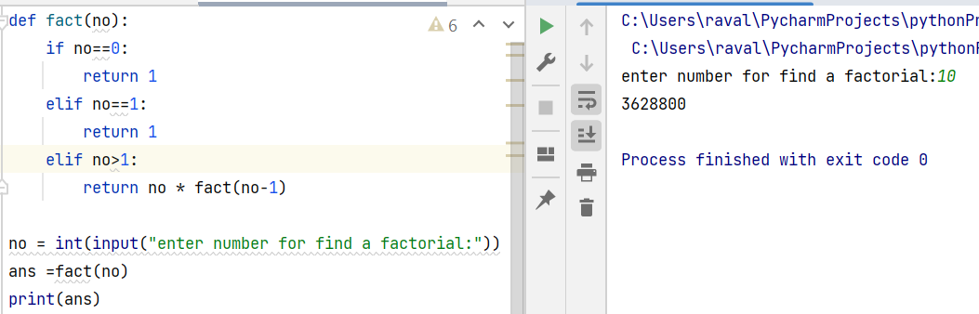
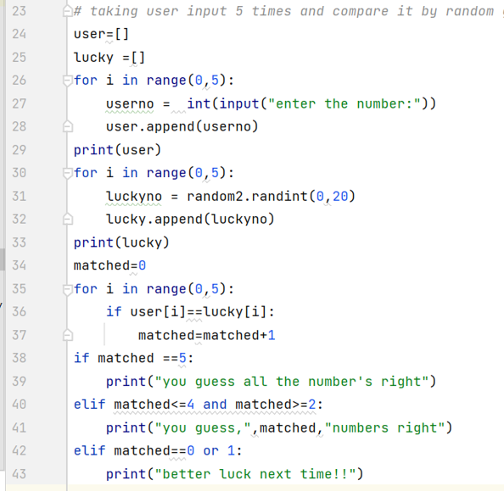
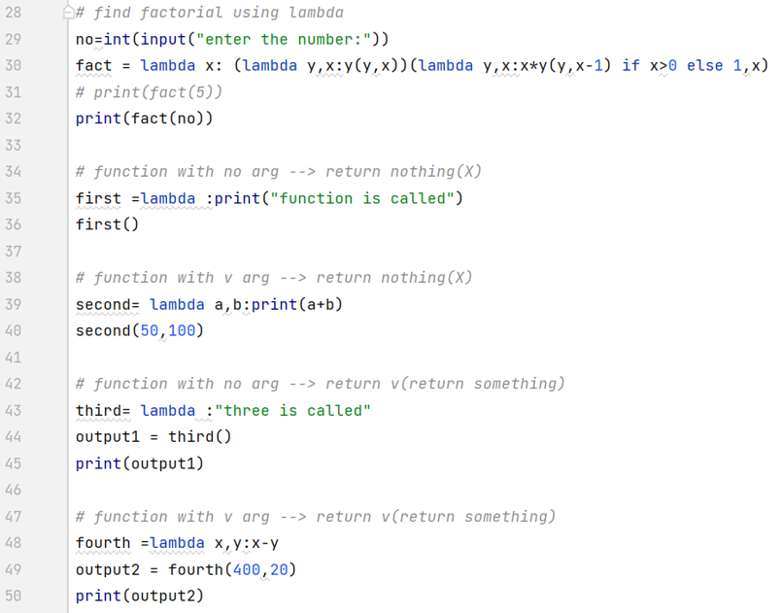
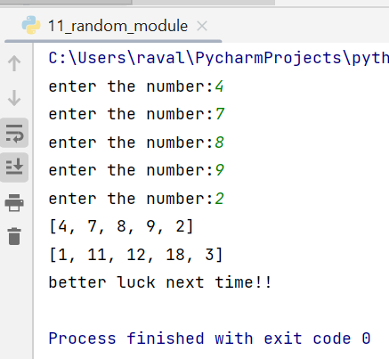
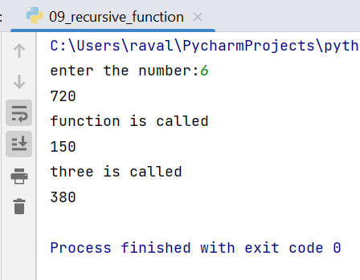
Week-03: Work Report
d
Functions in Python
Recursive Function in Python
Random module
Lambda Function in Python

Slide 13
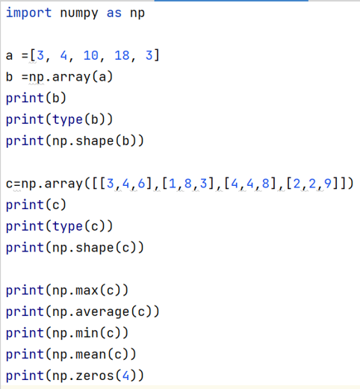
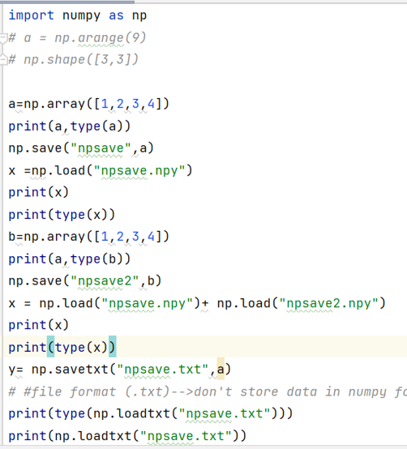
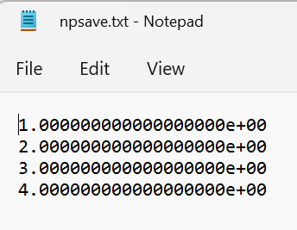
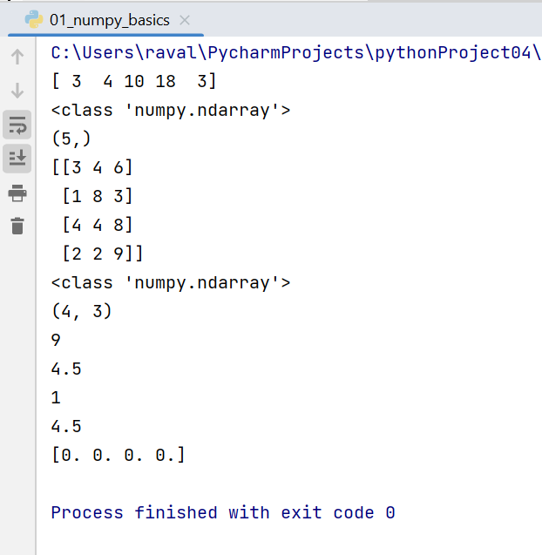
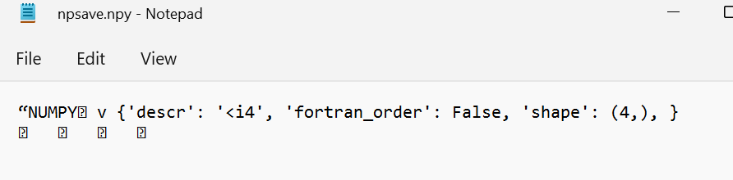
Numpy Library in Python
Numpy File Operations

Slide 14
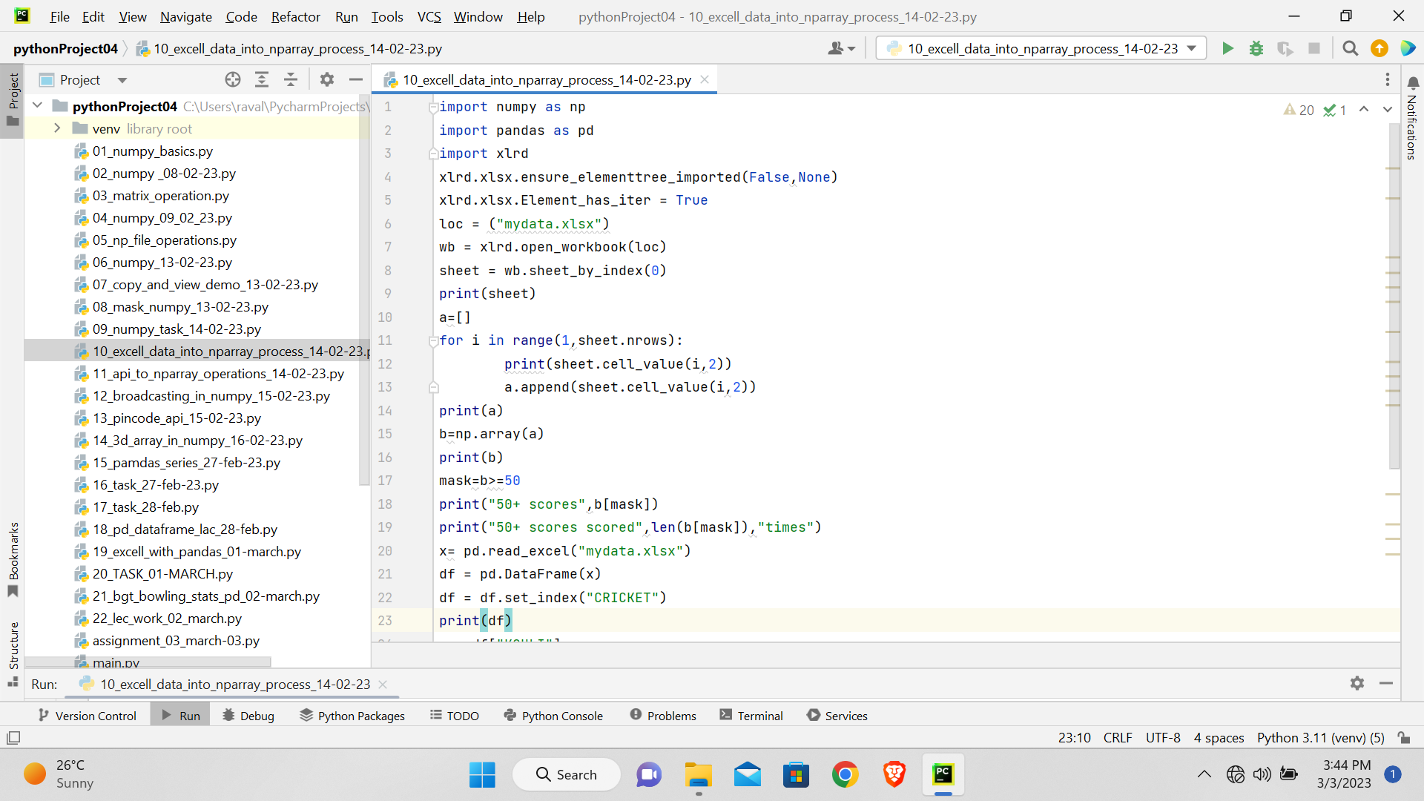
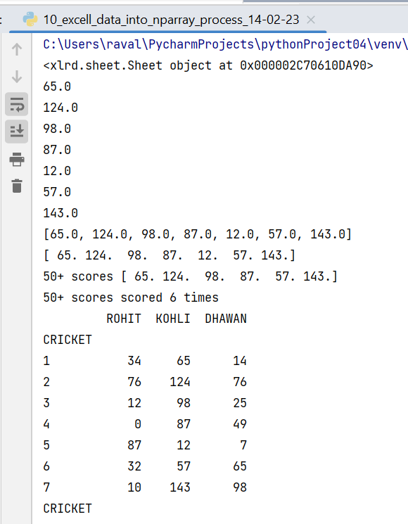
Week 4 and 5: numpy and visualization
Mask operation :

Slide 15
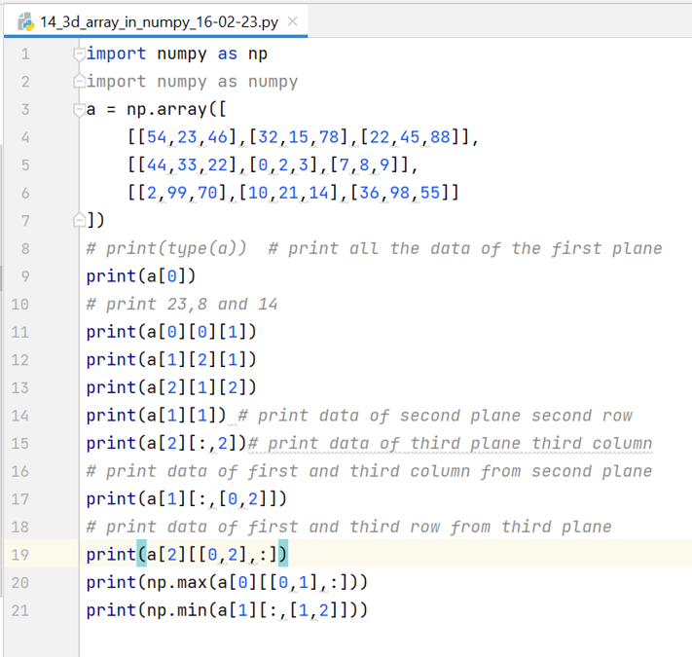
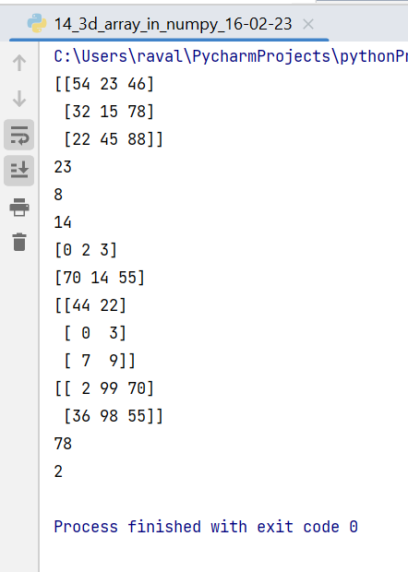
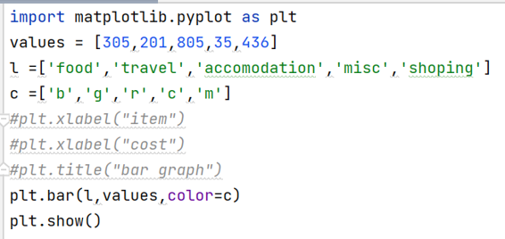
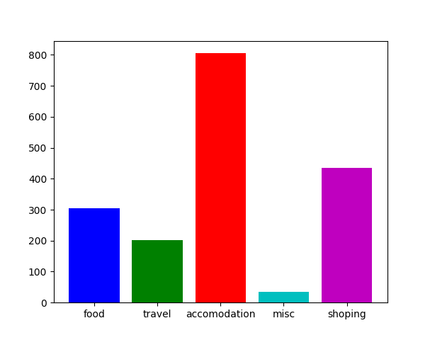
3D array in numpy and bar graph

Slide 16
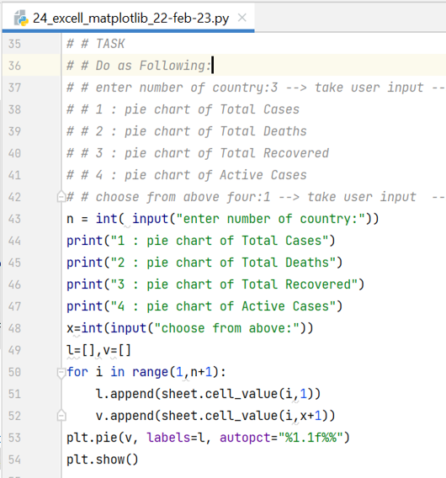
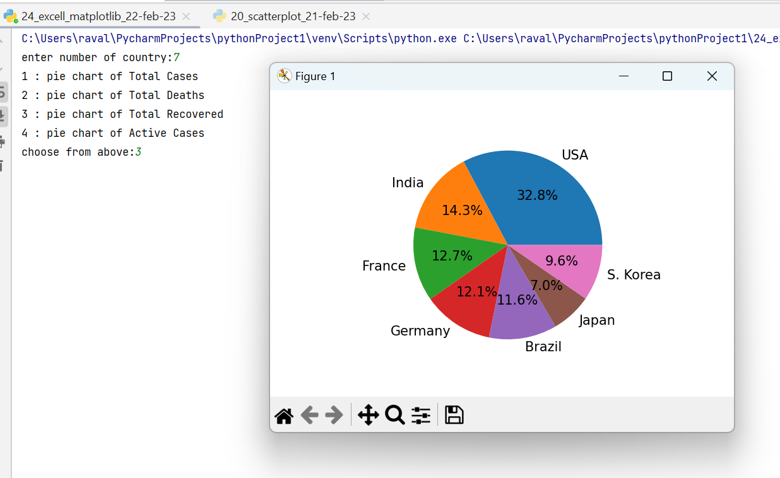
Creating pie chart

Slide 17
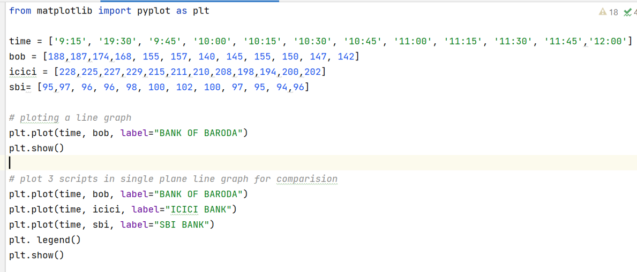
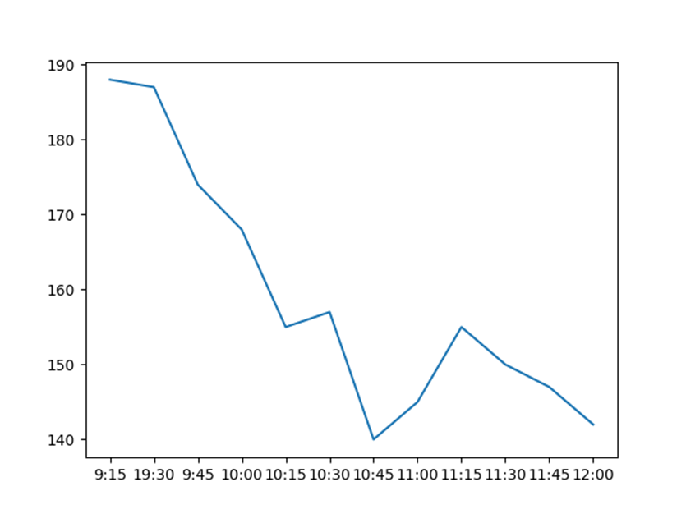
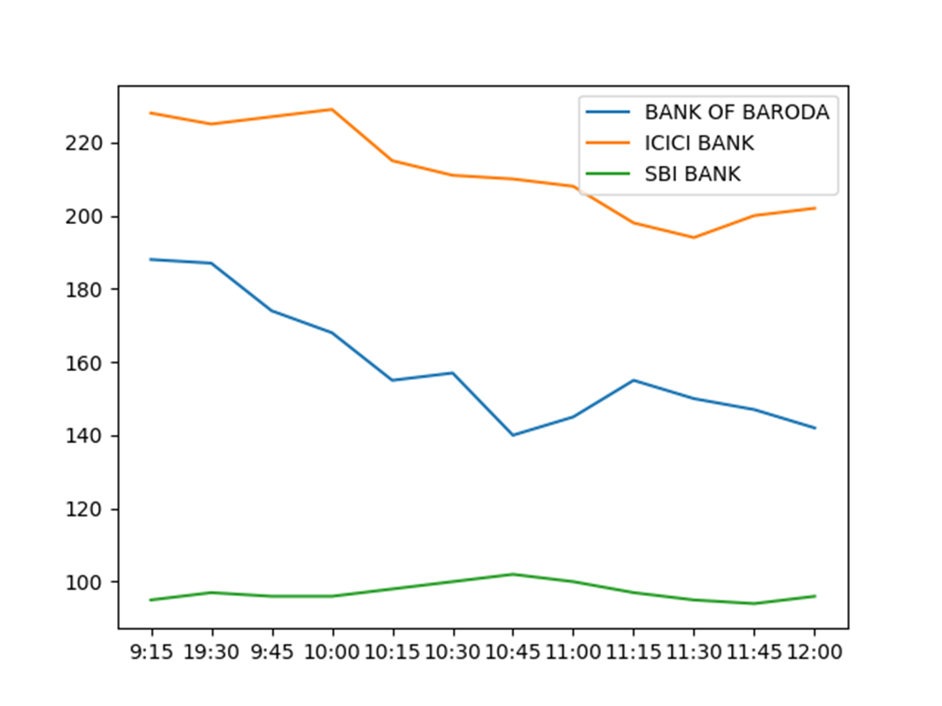
line &multiline chart

Slide 18
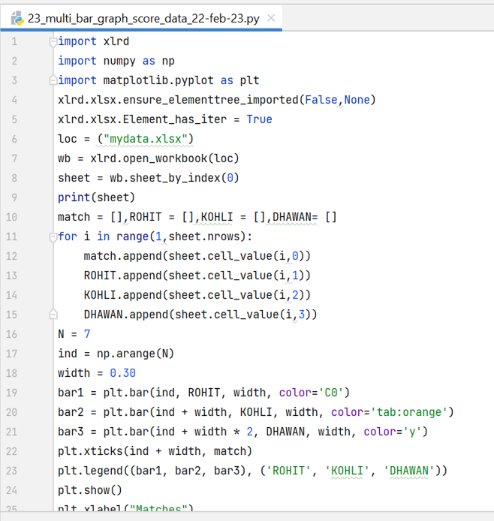
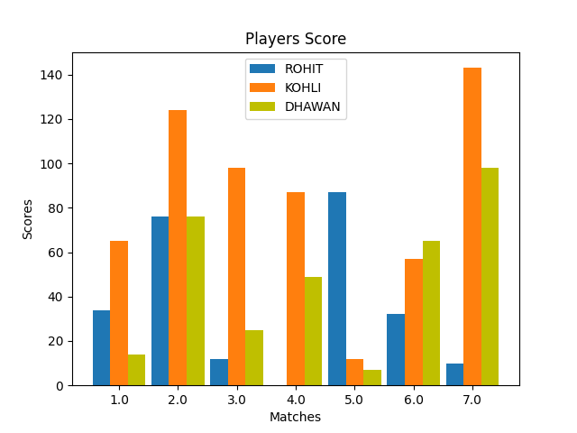
CREATE MULTI-BAR GRAPH

Slide 19
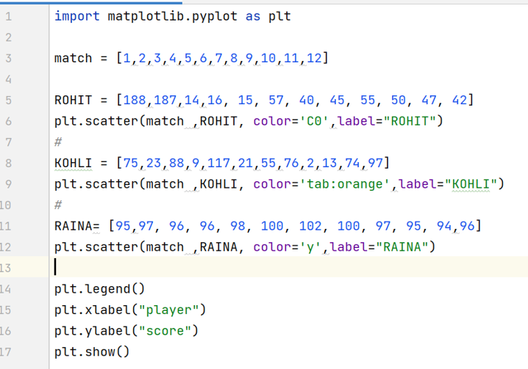
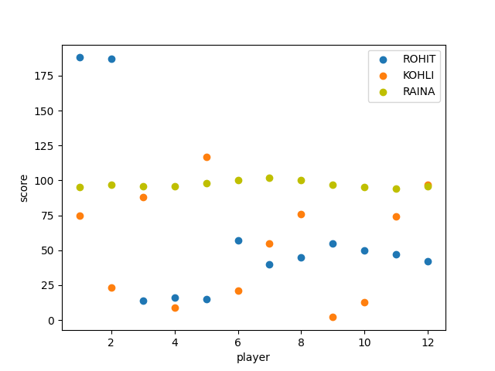
SCATTER PLOT

Slide 20
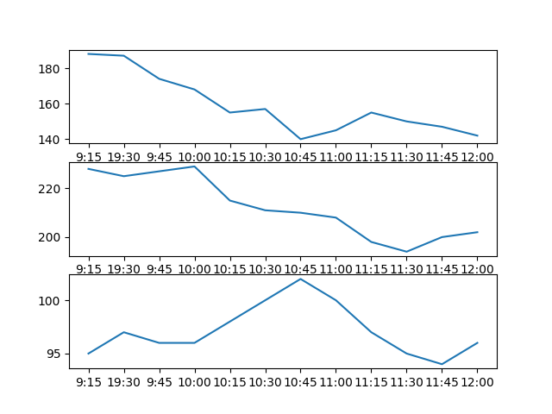
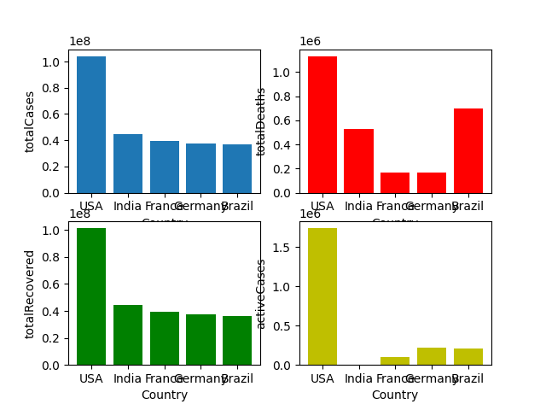
SUBPLOTS

Slide 21
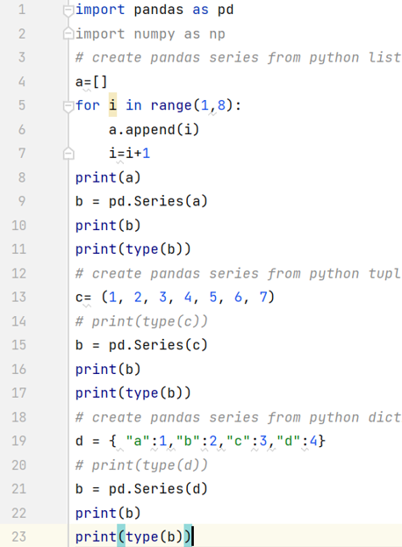
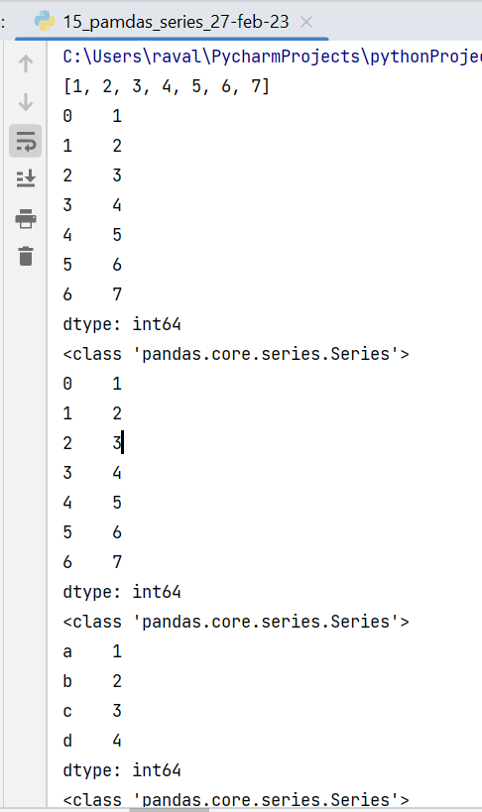
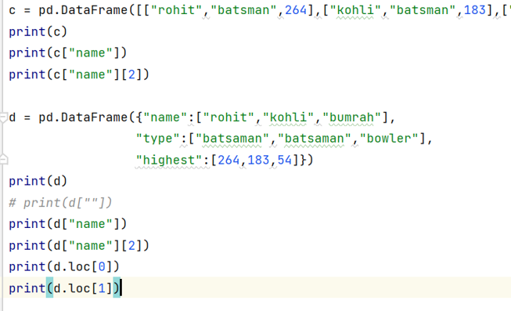
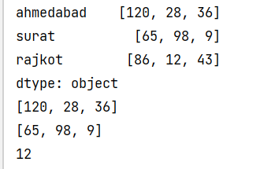
WEEK 6: PANDAS LIBRARY
Pandas Series
Pandas Dataframe

Slide 22
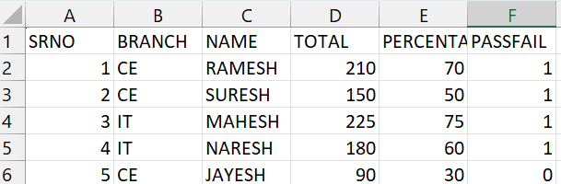
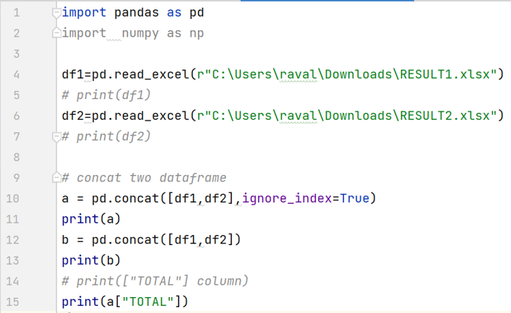
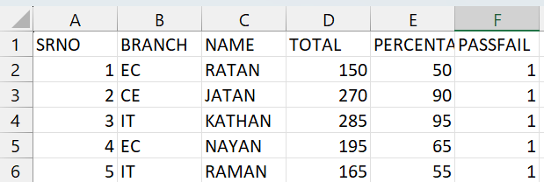
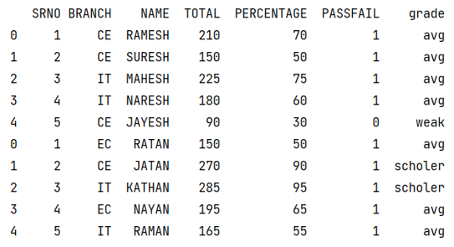
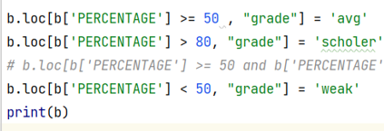
Merge and other operations in pandas Dataframe

Slide 23
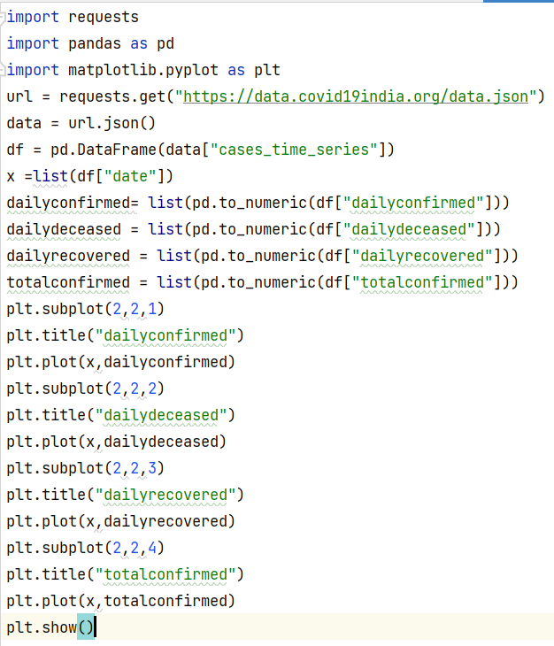
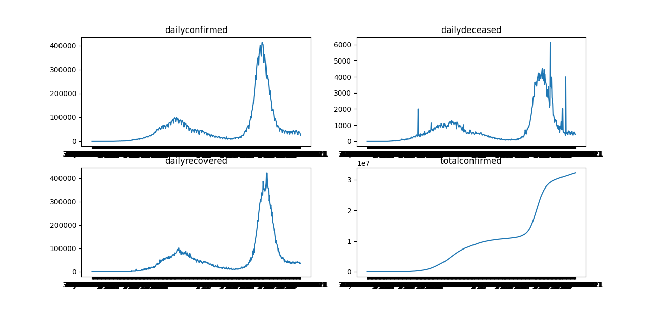
WEEK 7: API TO VISUALIZATION

Slide 24






DATA PRE-PROCESSING

Slide 25





DATA CLEANING

Slide 26




WEEK 8:
TEXT EXTRACTION

Slide 27



Week 9: Linear regression

Slide 28



Week 10: ML for Multi-independent var

Slide 29


Week 11: Tableau
Country wise sales
Top 5 customer per month

Slide 30


Quarterly analysis

Slide 31


Week 12: project work

Slide 32



Slide 33

References
https://www.tutorialspoint.com/excel_da ta_analysis/index.htm - Data Analysis
https://www.geeksforgeeks.org/machine- learning-with-python/ - ML Concepts
https://stackoverflow.com/ -for any programming query
https://inshorts.deta.dev/news?category= -API - date wise history
https://data.covid19india.org/data.json - covid 19 data API
https://api.coindesk.com/v1/bpi/currentprice.json -bitcoin API
https://api.postalpincode.in/pincode/382745 - Pin code API

Slide 34



THANK YOU!

